Slide 1


Sachi Patel, Steffi Patel, Chaitanya Kharche

Slide 2
Content
Introduction
Dataset Resources
Methods
Results
Game Insights
Conclusion

Slide 3
Description
Goal of this project is to analyze a comprehensive dataset containing information about Pokémon from various generations. By examining the relationships between various attributes such as base stats, types, generations, legendary status, and capture rate, we seek to uncover insights that can aid players in making informed decisions when attempting to catch Pokémon efficiently.
Previous studies have explored various aspects of Pokémon, including the impact of base stats on battle performance, type effectiveness, and evolutionary trends. However, limited research has been conducted specifically on the factors influencing capture rates. From this project we aim to fill that gap by focusing on the capture mechanics and providing a detailed analysis of the variables that contribute to the success of catching Pokémon.

Slide 4
Dataset
(https://www.kaggle.com/datasets/rounakbanik/pokemon?resource=download)
(https://www.kaggle.com/datasets/abcsds/pokemon)
Additional Resources:
https://www.kaggle.com/datasets/abcsds/pokemon
https://www.kaggle.com/datasets/rounakbanik/pokemon?resource=download
https://pokemondb.net/pokedex/stats/height-weight
https://www.smogon.com/ingame/guides/capture_mechanics#:~:text=The%20Capture%20Rate%20Formula,-The%20Capture%20Rate&text=The%20equation%20is%20based%20on,more%20denotes%20a%20guaranteed%20capture

Slide 5
Methods
Data Pre-Processing
Exploratory Data Analysis
Statistical Analysis
Predictive Models

Slide 6
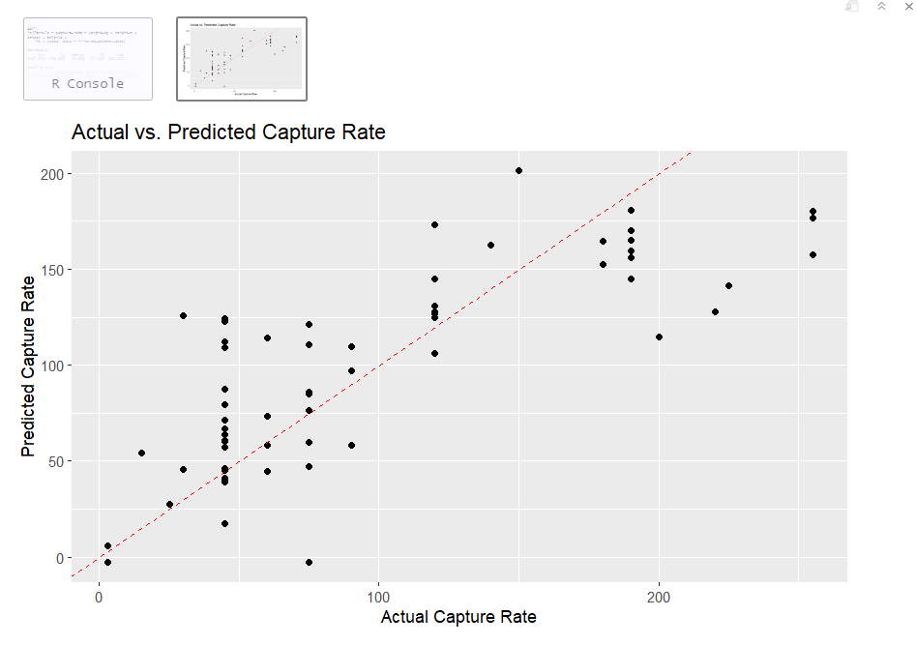
Results

Slide 7
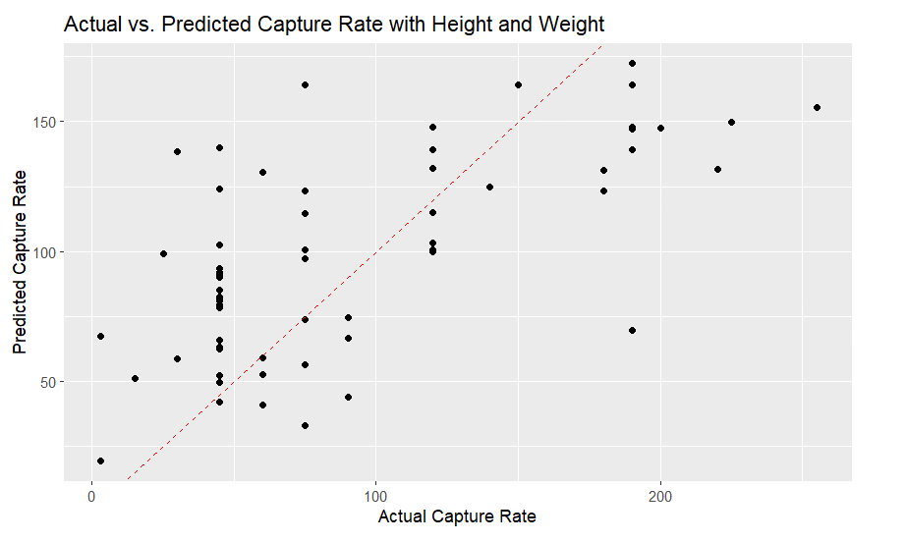

Slide 8
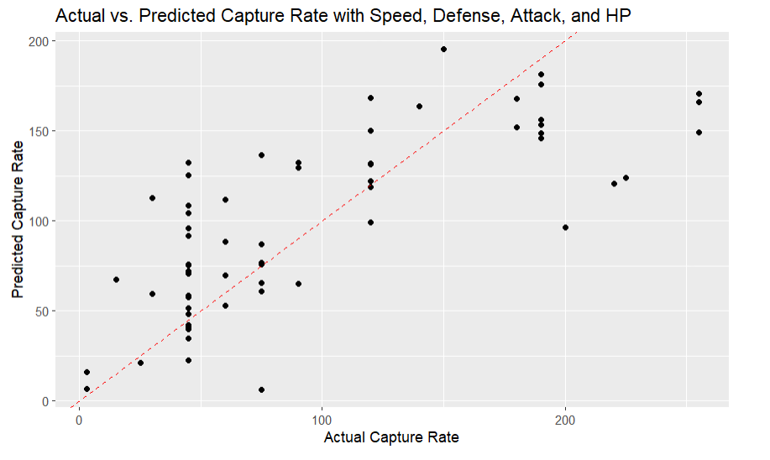

Slide 9
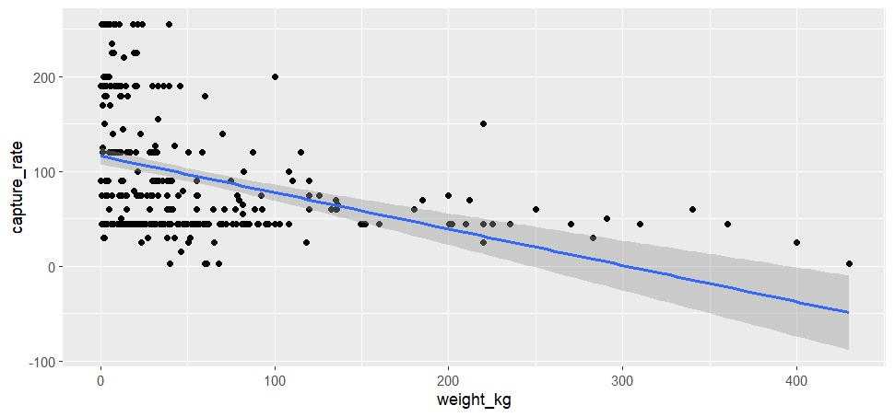
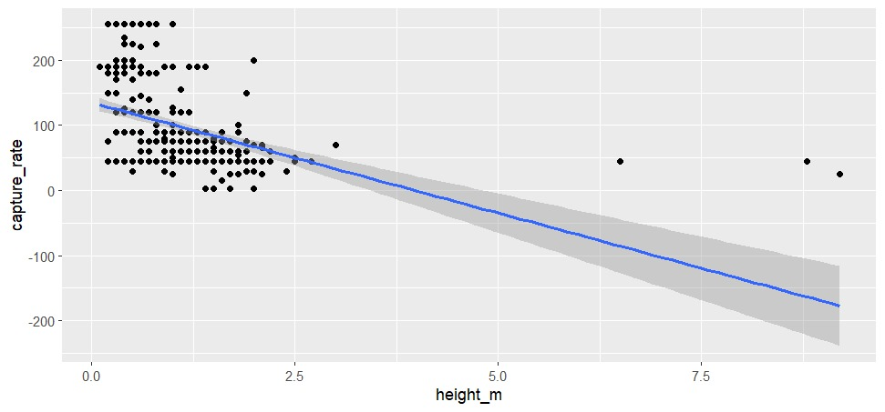
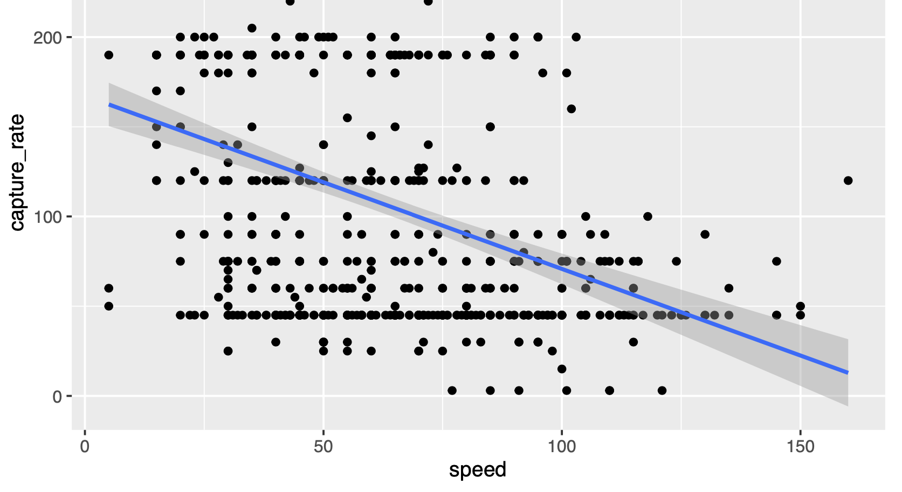
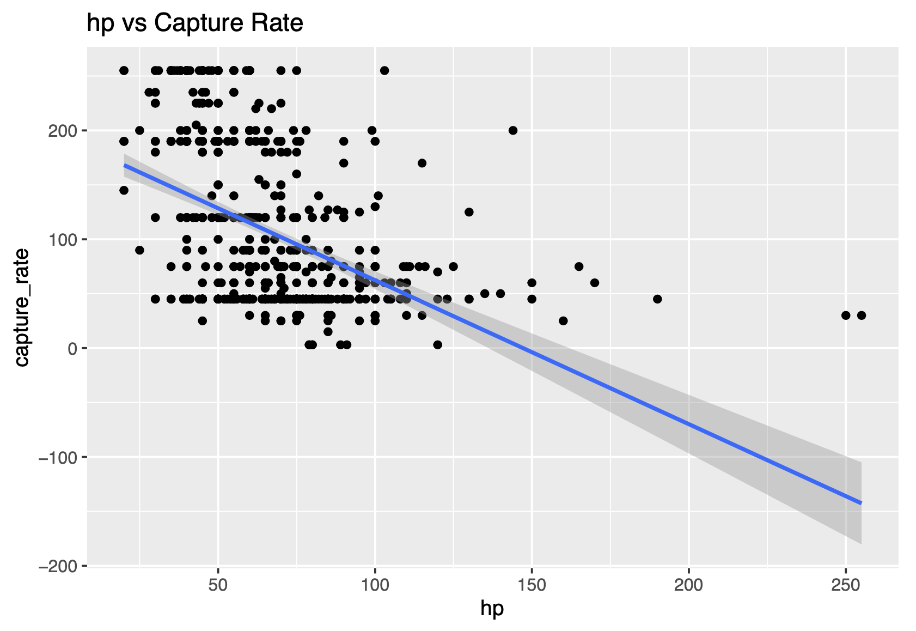
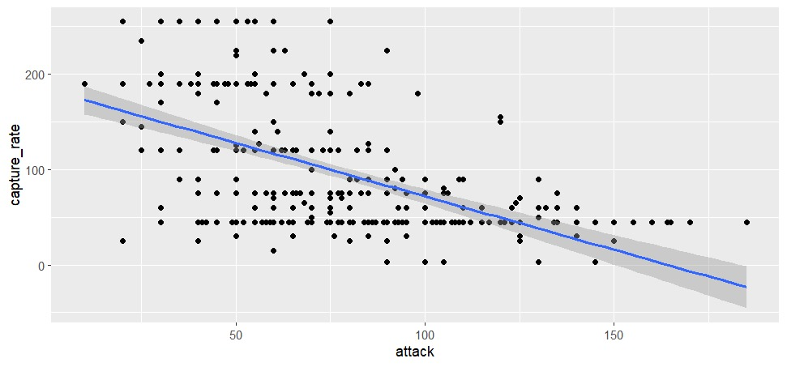
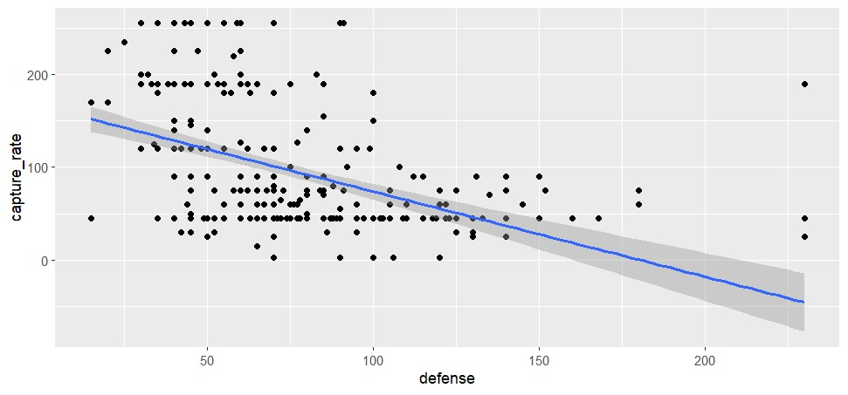
Base Stats and Capture Rate

Slide 10
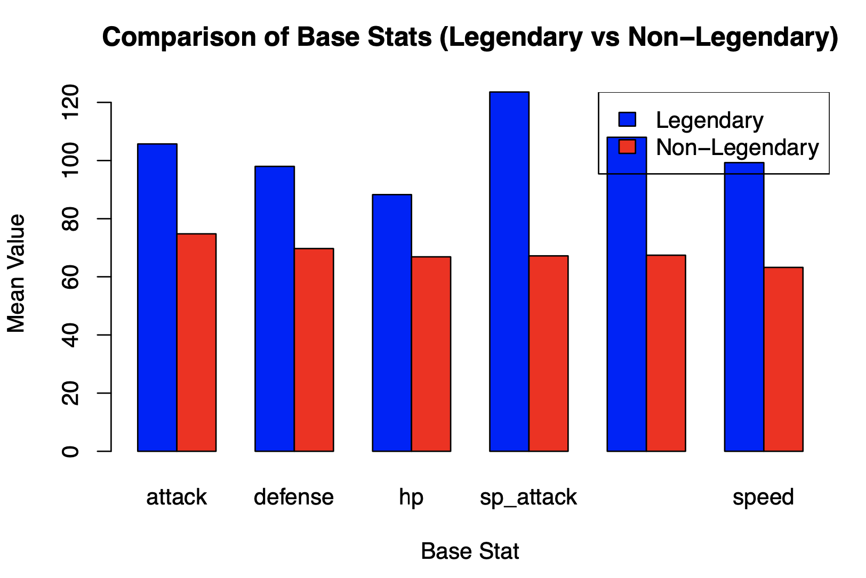
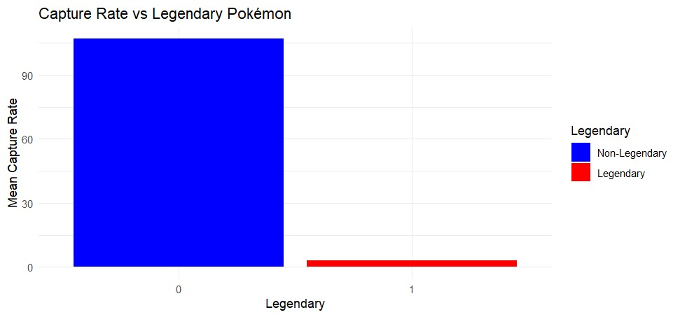
Legendary Pokémon and Capture Rate

Slide 11
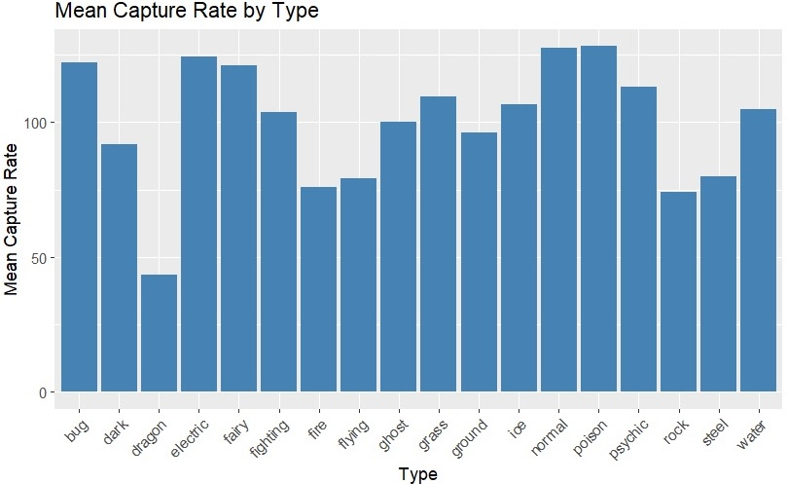
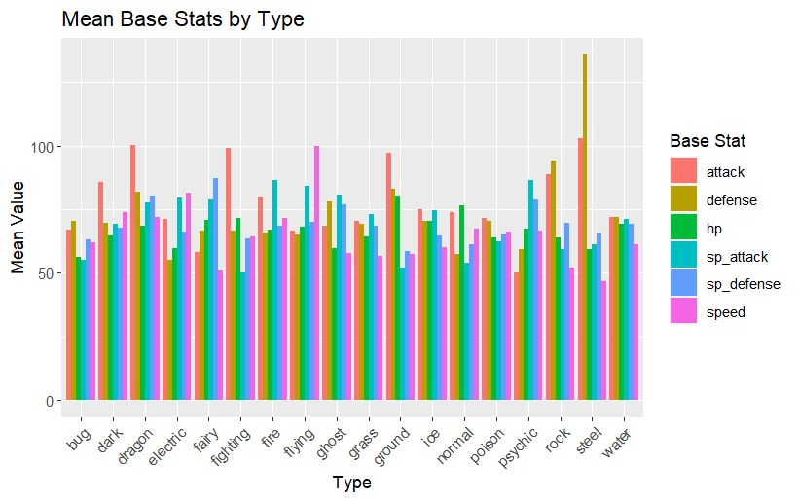
Type and Capture Rate

Slide 12
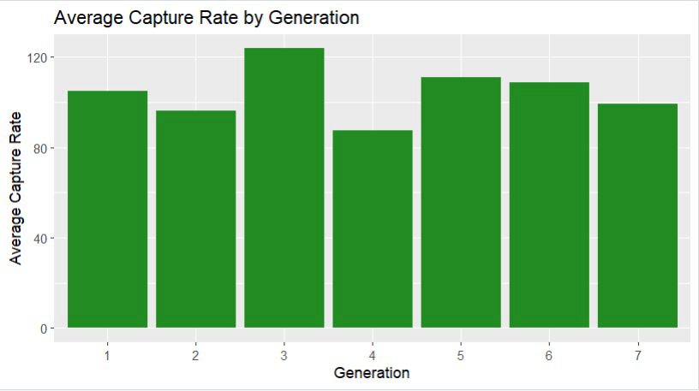
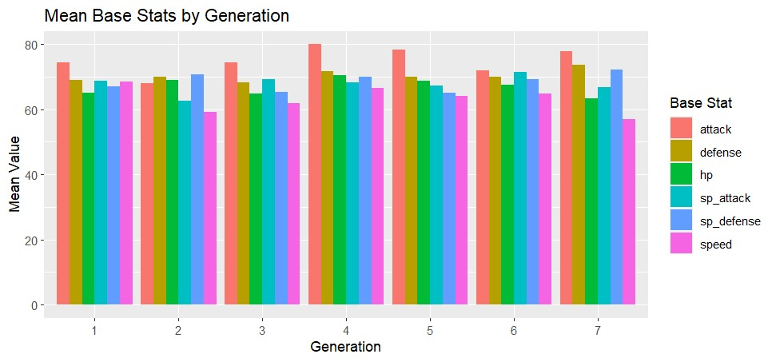
Generation and Capture Rate

Slide 13
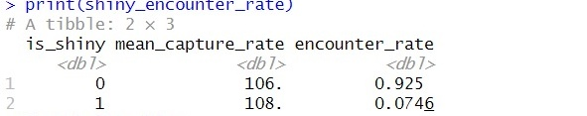
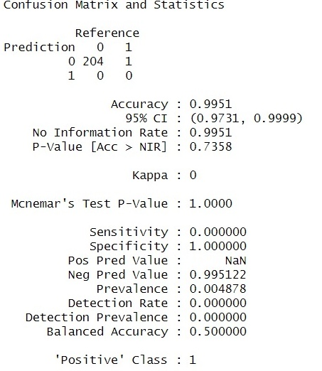
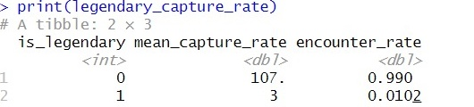
Predictive Models

Slide 14
Game Insights and Recommendations
Catching Pokémon
Legendary vs. Non-legendary
Highest Capture rate
Use berries
Participate in game promotion

Slide 15
Conclusion
Findings of this projects highlight the importance of considering a Pokémon's overall strength, rarity, and type when developing capture strategies.
The predictive models developed in this project can serve as a valuable tool for players to estimate capture rates and optimize their resource allocation.
Future work can expand on this by incorporating additional features, such as move sets, abilities, and catch location, to provide more granular insights.
Exploring advanced machine learning techniques and conducting user studies to validate the findings and gather feedback from players can further enhance the practical applicability of this project.

Slide 16
Thank You! Any Questions?

